Slide 1
DataBase

Slide 2
Relational DataBase
Design

Slide 3
logical database design
  also known as data model mapping
procedures to create a relational schema from an Entity–Relationship (ER) or Enhanced ER (EER) schema

Slide 4
Mapping Entity Relationship
ER Model Constructs to Relations

Slide 5
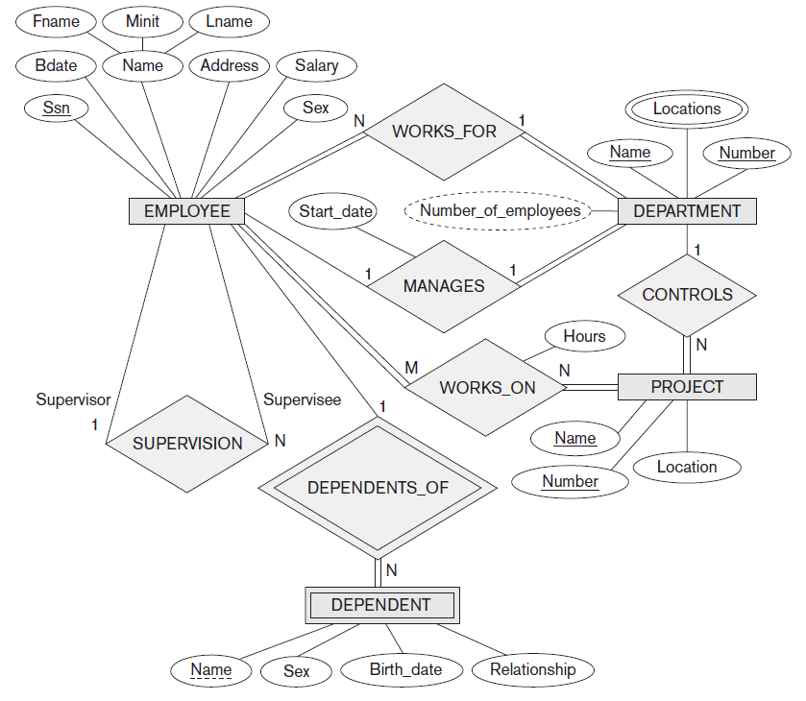

Slide 6
ER-to-Relational Mapping
algorithm for ER-to-relational mapping
the COMPANY database example ER shown before
COMPANY relational database schema shown after
  tables with simple single valued attributes
Primary Keys, unique keys (if any), and referential integrity constraints on relations

Slide 7
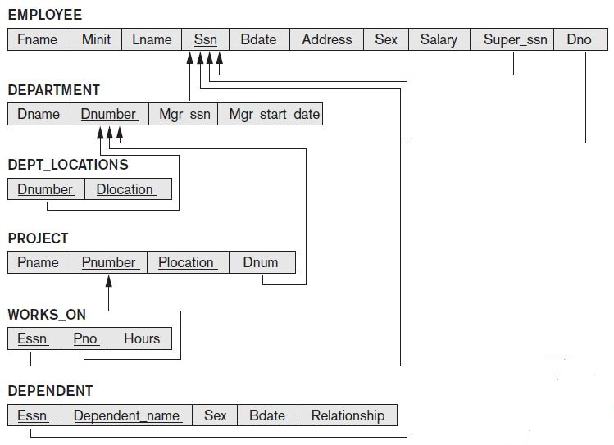

Slide 8
Step 1: Mapping of Regular Entity Types
for each regular (strong) entity type E in the ER schema, create relation R that includes all simple attributes of E
include only simple component attributes of composite attribute

Slide 9
Step 1: Mapping of Regular Entity Types
choose one of key attributes of E as primary key for R
if chosen key of E is a composite, then the set of simple attributes that form it will together form primary key of R
if multiple keys were identified for E during conceptual design, information describing attributes that form each additional key is kept in order to specify additional (unique) keys of relation R
knowledge about keys is also kept for indexing purposes and other types of analyses

Slide 10
EMPLOYEE, DEPARTMENT, and PROJECT

Slide 11
Step 2: Mapping of Weak Entity Types
for each weak entity type W in ER schema with owner entity type E, create a relation R and include all simple attributes (or simple components of composite attributes) of W as attributes of R
in addition, include as foreign key attributes of R, the primary key attribute(s) of relation(s) that correspond to owner entity type(s); this takes care of mapping identifying relationship type of W
primary key of R is combination of primary key(s) of owner(s) and partial key of weak entity type W, if any
if there is weak entity type E2 whose owner is also a weak entity type E1, then E1 should be mapped before E2

Slide 12
Step 2: Mapping of Weak Entity Types
it is common to choose the propagate (CASCADE) option for the referential triggered action on the foreign key in the relation corresponding to the weak entity type, since a weak entity has an existence dependency on its owner entity
used for both ON UPDATE and ON DELETE

Slide 13
DEPENDENT

Slide 14
Step 3: Mapping of Binary 1:1 Relationship Types
for each binary 1:1 relationship type R in the ER schema, identify the relations S and T that correspond to the entity types participating in R
there are three possible approaches:
foreign key approach
merged relationship approach
cross-reference or relationship relation approach
the first approach is the most useful and should be followed unless special conditions exist

Slide 15
Step 3: Mapping of Binary 1:1 Relationship Types
1. Foreign key approach
choose one of the relations - S, say - and include as a foreign key in S the primary key of T
better to choose an entity type with total participation in R in the role of S
include all simple attributes (or simple components of composite attributes) of the 1:1 relationship type R as attributes of S
note that it is possible to include the primary key of S as a foreign key in T instead

Slide 16
Step 3: Mapping of Binary 1:1 Relationship Types
2. Merged relation approach
alternative mapping of a 1:1 relationship type is to merge the two entity types and the relationship into a single relation
possible when both participations are total, as this would indicate that the two tables will have the exact same number of tuples at all times

Slide 17
Step 3: Mapping of Binary 1:1 Relationship Types
3. Cross-reference or relationship relation approach
the third option is to set up a third relation R for the purpose of cross-referencing the primary keys of the two relations S and T representing the entity types
this approach is required for binary M:N relationships
relation R is called a relationship relation (or sometimes a lookup table), because each tuple in R represents a relationship instance that relates one tuple from S with one tuple from T
the relation R will include the primary key attributes of S and T as foreign keys to S and T
primary key of R will be one of the two foreign keys, and the other foreign key will be a unique key of R

Slide 18
Step 3: Mapping of Binary 1:1 Relationship Types
3. Cross-reference or relationship relation approach
drawback is having an extra relation, and requiring extra join operations when combining related tuples from the tables

Slide 19
map the 1:1 relationship type MANAGES by choosing participating entity type DEPARTMENT to serve in the role of S because its participation in the MANAGES relationship type is total (every department has a manager)
include primary key of EMPLOYEE relation as foreign key in DEPARTMENT relation and rename it to Mgr_ssn
also include the simple attribute Start_date of MANAGES relationship type in DEPARTMENT relation and rename Mgr_start_date

Slide 20
amounts to having a foreign key attribute, say Department_managed in EMPLOYEE relation, but it will have a NULL value for employee tuples who do not manage a department - this would be a bad choice, because if only 2% of employees manage a department, then 98% of foreign keys would be NULL in this case
another possibility is to have foreign keys in both relations S and T redundantly, but this creates redundancy and incurs a penalty for consistency maintenance

Slide 21
Step 4: Mapping of Binary 1:N Relationship Types
there are two possible approaches:
foreign key approach
cross-reference or relationship relation approach
first approach is generally preferred as it reduces the number of tables

Slide 22
Step 4: Mapping of Binary 1:N Relationship Types
1. The foreign key approach
for each regular binary 1:N relationship type R, identify relation S that represents the participating entity type at the N-side of the relationship type
include as foreign key in S the primary key of the relation T that represents the other entity type participating in R; because each entity instance on the N-side is related to at most one entity instance on the 1-side of the relationship type
include any simple attributes (or simple components of composite attributes) of the 1:N relationship type as attributes of S

Slide 23
Step 4: Mapping of Binary 1:N Relationship Types
2. The relationship relation approach
alternative approach is to use the relationship relation (cross-reference) option as in the third option for binary 1:1 relationships
create a separate relation R whose attributes are the primary keys of S and T, which will also be foreign keys to S and T
primary key of R is the same as the primary key of S
option can be used if few tuples in S participate in relationship to avoid excessive NULL values in foreign key

Slide 24
map the 1:N relationship types WORKS_FOR, CONTROLS, and SUPERVISION
for WORKS_FOR include primary key Dnumber of DEPARTMENT relation as foreign key in EMPLOYEE relation and call it Dno
for SUPERVISION include primary key of EMPLOYEE relation as foreign key in EMPLOYEE relation itself - because relationship is recursive - and call it Super_ssn
CONTROLS relationship is mapped to foreign key attribute Dnum of PROJECT, which references primary key Dnumber of DEPARTMENT relation

Slide 25
Step 5: Mapping of Binary M:N Relationship Types
traditional relational model with no multivalued attributes, only option for M:N relationships is the relationship relation (cross-reference) option
for each binary M:N relationship type R, create a new relation S to represent R; include as foreign key attributes in S the primary keys of the relations that represent the participating entity types; their combination will form the primary key of S
also include any simple attributes of the M:N relationship type (or simple components of composite attributes) as attributes of S
cannot represent an M:N relationship type by a single foreign key attribute in one of the participating relations

Slide 26
Step 5: Mapping of Binary M:N Relationship Types
propagate (CASCADE) option for referential triggered action should be specified on foreign keys in relation corresponding to relationship R, since each relationship instance has an existence dependency on each of the entities it relates
used for both ON UPDATE and ON DELETE.
although we can map 1:1 or 1:N relationships in a manner similar to M:N relationships by using the cross-reference (relationship relation) approach, this is only recommended when few relationship instances exist, in order to avoid NULL values in foreign keys

Slide 27
map the M:N relationship type WORKS_ON by creating the relation WORKS_ON
include the primary keys of PROJECT and EMPLOYEE relations as foreign keys in WORKS_ON and rename them Pno and Essn, respectively (renaming is not required; it is a design choice)
also include an attribute Hours in WORKS_ON to represent the Hours attribute of the relationship type
primary key of WORKS_ON relation is combination of foreign key attributes {Essn, Pno}

Slide 28
Step 6: Mapping of Multivalued Attributes
for each multivalued attribute A, create a new relation R
this relation R will include attribute corresponding to A, plus the primary key attribute K - as foreign key in R - of the relation that represents the entity type or relationship type that has A as a multivalued attribute
primary key of R is combination of A and K
if the multivalued attribute is composite, we include its simple components

Slide 29
Step 6: Mapping of Multivalued Attributes
propagate (CASCADE) option for referential triggered action should be specified on foreign key in relation R corresponding to multivalued attribute for both ON UPDATE and ON DELETE
key of R when mapping a composite, multivalued attribute requires some analysis of the meaning of the component attributes; in some cases, when a multivalued attribute is composite, only some of the component attributes are required
in more recent versions of the relational model (PostGreSQL, …) that allow array data types, the multivalued attribute can be mapped to an array attribute rather than requiring a separate table

Slide 30
we create a relation DEPT_LOCATIONS
attribute Dlocation represents the multivalued attribute LOCATIONS of DEPARTMENT, whereas Dnumber - as foreign key - represents the primary key of DEPARTMENT relation
primary key of DEPT_LOCATIONS is combination of {Dnumber, Dlocation}
separate tuple will exist in DEPT_LOCATIONS for each location that a department has

Slide 31
Step 7: Mapping of N-ary Relationship Types use the relationship relation option
for each n-ary relationship type R, where n > 2, create a new relationship relation S to represent R
include as foreign key attributes in S the primary keys of the relations that represent the participating entity types; also include any simple attributes of the n-ary relationship type (or simple components of composite attributes) as attributes of S
primary key of S is usually a combination of all the foreign keys that reference the relations representing the participating entity types

Slide 32
Step 7: Mapping of N-ary Relationship Types use the relationship relation option
if the cardinality constraints on any of the entity types E participating in R is 1, then the primary key of S should not include the foreign key attribute that references the relation E’ corresponding to E

Slide 33
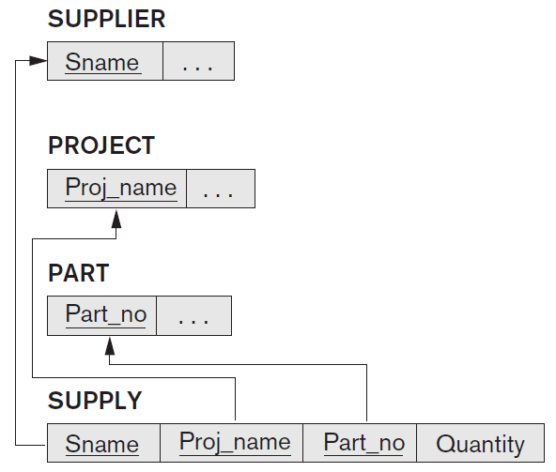
ternary relationship type SUPPLY

Slide 34
ternary relationship type SUPPLY relates a SUPPLIER s, PART p, and PROJECT j whenever s is currently supplying p to j
can be mapped to relation SUPPLY whose primary key is the combination of the three foreign keys {Sname, Part_no, Proj_name}

Slide 35
ER MODEL | RELATIONAL MODEL
Entity type | Entity relation
1:1 or 1:N relationship type | Foreign key (or relationship relation)
M:N relationship type | Relationship relation and two foreign keys
n-ary relationship type | Relationship relation and n foreign keys
Simple attribute | Attribute

Slide 36
ER MODEL | RELATIONAL MODEL
Composite attribute | Set of simple component attributes
Multivalued attribute | Relation and foreign key
Value set | Domain
Key attribute | Primary (or secondary) key

Slide 37
relationship types are not represented explicitly; represented by having two attributes A and B, one a primary key and the other a foreign key (over the same domain) included in two relations S and T
two tuples in S and T are related when they have the same value for A and B

Slide 38
using the EQUIJOIN operation over S.A and T.B, we can combine all pairs of related tuples from S and T and materialize the relationship
when a binary 1:1 or 1:N relationship type is involved and foreign key mapping is used, a single join operation is usually needed
when relationship relation approach is used, such as for a binary M:N relationship type, two join operations are needed,
for n-ary relationship types, n joins are needed to fully materialize the relationship instances

Slide 39
Mapping Enhanced Entity Relationship
EER Model Constructs to Relations

Slide 40
Mapping of Specialization or Generalization
two main options
map the whole specialization into a single table
map it into multiple tables
within each option are variations that depend on the constraints on the specialization/generalization !

Slide 41
Step 8: Options for Mapping
Specialization or Generalization
can add a further step to our ER-to-relational mapping algorithm to handle the mapping of specialization
use Attrs(R) to denote the attributes of a relation R, and PK(R) to denote the primary key of R.
convert each specialization with m subclasses {S1, S2, … , Sm} and (generalized) superclass C, where the attributes of C are {k, a1, … , an} and k is the (primary) key, into relation schemas using one of the following options:

Slide 42
A. multiple-relation options special and general relations

Slide 43
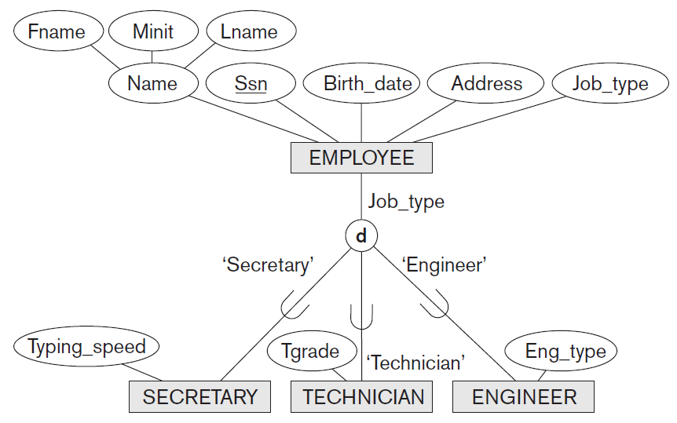

Slide 44
Option 8A: Multiple relations—superclass and subclasses
create a relation L for C with attributes Attrs(L) = {k, a1, … , an} and PK(L) = k
create a relation Li for each subclass Si, 1 ≤ i ≤ m, with the attributes Attrs(Li) = {k} ∪ {attributes of Si} and PK(Li) = k
this option works for any specialization (total or partial, disjoint or overlapping)

Slide 45
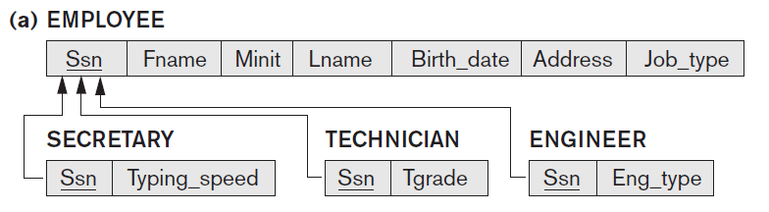

Slide 46
CREATE VIEW
Employee_Secretary: Ssn, Fname, Minit, Lname, Birth_date, Address, Job_type, Typing_speed
Employee_Technician: Ssn, Fname, Minit, Lname, Birth_date, Address, Job_type, Tgrade
Employee_Engineer: Ssn, Fname, Minit, Lname, Birth_date, Address, Job_type, Eng_type

Slide 47
B. multiple-relation options special relations

Slide 48
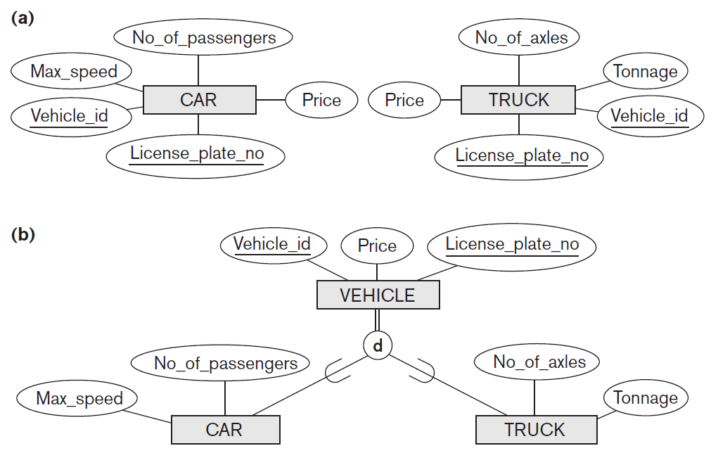

Slide 49
Option 8B: Multiple relations—subclass relations only
create a relation Li for each subclass Si, 1 ≤ i ≤ m, with the attributes Attrs(Li) = {attributes of Si} ∪ {k, a1, … , an} and PK(Li) = k
this option only works for a specialization whose subclasses are total (every entity in the superclass must belong to (at least) one of the subclasses)
it is only accepted if specialization has the disjointedness constraint - if the specialization is overlapping, the same entity may be duplicated in several relations

Slide 50
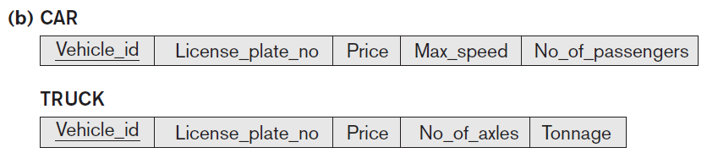

Slide 51
CREATE VIEW
VEHICLE as
SELECT Vehicle_id, Licenze_plate_no, Price FROM CAR
UNION
SELECT Vehicle_id, Licenze_plate_no, Price FROM TRUCK

Slide 52
C. single-relation options general relation

Slide 54
Option 8C: Single relation with one type attribute.
create a single relation L with attributes Attrs(L) = {k, a1, …, an} ∪ {attributes of S1} ∪ … ∪ {attributes of Sm} ∪ {t} and PK(L) = k.
the attribute t is called a type (or discriminating) attribute whose value indicates the subclass to which each tuple belongs, if any
this option works only for a specialization whose subclasses are disjoint, and has the potential for generating many NULL values if many specific (local) attributes exist in the subclasses

Slide 56
D. single-relation options general relation

Slide 57
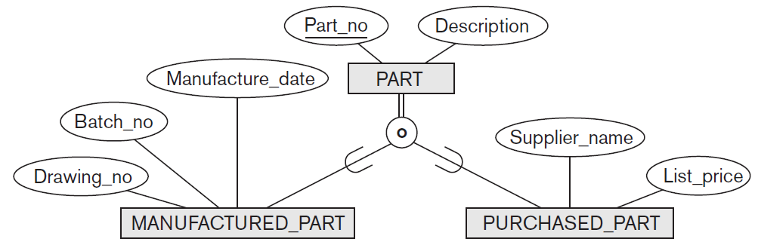

Slide 58
Option 8D: Single relation with multiple type attributes
create a single relation schema L with attributes Attrs(L) = {k, a1, …, an} ∪ {attributes of S1} ∪ … ∪ {attributes of Sm} ∪ {t1, t2, …, tm} and PK(L) = k. Each ti, 1 ≤ i ≤ m, is a Boolean type attribute indicating whether or not a tuple belongs to subclass Si
this option is used for a specialization whose subclasses are overlapping (but will also work for a disjoint specialization)

Slide 60
Recommend
Step 8. Option 8A creates a relation L for superclass C and its attributes, plus a relation L_{i} for each subclass S_{i}; each L_{i} includes the specific (local) attributes of S_{i}, plus primary key of superclass C, which is propagated to L_{i} and becomes its primary key - it also becomes a foreign key to the superclass relation
an EQUIJOIN operation on primary key between any L_{i} and L produces all the specific and inherited attributes of the entities in S_{i}
works for any constraints on the specialization: disjoint or overlapping, total or partial

Slide 61
Recommend
works for any constraints on the specialization: disjoint or overlapping, total or partial
π_{<k>}(L_{i}) ⊆ π_{<k>}(L)
must hold for each L_{i}; this specifies a foreign key from each L_{i} to L

Slide 62
in option 8B, the EQUIJOIN operation between each subclass and the superclass is built into the schema and the superclass relation L is done away with
option works well only when both the disjoint and total constraints hold; if specialization is not total, an entity that does not belong to any of the subclasses Si is lost; if specialization is not disjoint, an entity belonging to more than one subclass will have its inherited attributes from the superclass C stored redundantly in more than one table Li

Slide 63
options 8C and 8D create a single relation to represent the superclass C and all its subclasses
an entity that does not belong to some of the subclasses will have NULL values for the specific (local) attributes of these subclasses
these options are not recommended if many specific attributes are defined for the subclasses; if few local subclass attributes exists, these mappings are preferable to options 8B because they do away with the need to specify JOIN operations; therefore, they can yield a more efficient implementation for queries
Option 8C is used to handle disjoint subclasses by including a single type (or image
or discriminating) attribute t to indicate to which of the m subclasses each tuple
belongs; hence, the domain of t could be {1, 2, … , m}. If the specialization is partial, t
can have NULL values in tuples that do not belong to any subclass. If the specialization
is attribute-defined, that attribute itself serves the purpose of t and t is not needed; this
option is illustrated in Figure 9.5(c) for the EER specialization in Figure 4.4.
Option 8D is designed to handle overlapping subclasses by including m Boolean
type (or flag) fields, one for each subclass. It can also be used for disjoint subclasses.

Slide 64
options 8C and 8D create a single relation to represent the superclass C and all its subclasses
an entity that does not belong to some of the subclasses will have NULL values for the specific (local) attributes of these subclasses
these options are not recommended if many specific attributes are defined for the subclasses; if few local subclass attributes exists, these mappings are preferable to options 8B because they do away with the need to specify JOIN operations; therefore, they can yield a more efficient implementation for queries

Slide 65
option 8C is used to handle disjoint subclasses by including a single type (or image or discriminating) attribute t to indicate to which of the m subclasses each tuple belongs; hence, the domain of t could be {1, 2, … , m}
if the specialization is partial, t can have NULL values in tuples that do not belong to any subclass
if the specialization is attribute-defined, that attribute itself serves the purpose of t and t is not needed

Slide 66
option 8D is designed to handle overlapping subclasses by including m Boolean type (or flag) fields, one for each subclass
it can also be used for disjoint subclaEach type field t_{i} can have a domain {yes, no}, where a value of yes indicates that the tuple is a member of subclass S_{i}

Slide 67
for a multilevel specialization (or generalization) hierarchy, we do not have to follow the same mapping option for all the specializations; instead, we can use one mapping option for part of the hierarchy and other options for other parts

Slide 69
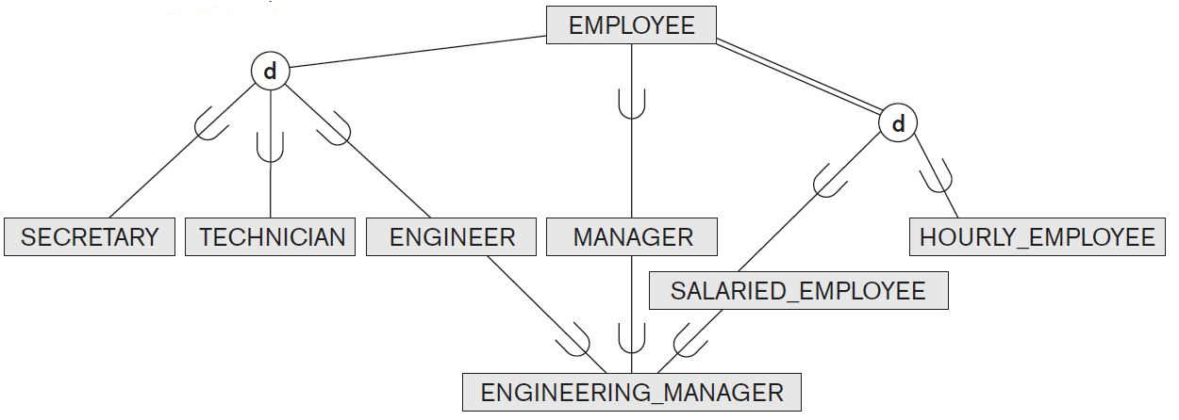

Slide 70
Mapping of Shared Subclasses (Multiple Inheritance)
shared subclass, such as ENGINEERING_MANAGER is a subclass of several superclasses, indicating multiple inheritance
these classes must all have the same key attribute; otherwise, the shared subclass would be modeled as a category (union type)
can apply any of the options discussed in step 8 to a shared subclass, subject to the restrictions
options 8C and 8D are used for the shared subclass STUDENT_ASSISTANT
option 8C is used in the EMPLOYEE relation (Employee_type attribute)
option 8D is used in the STUDENT relation (Student_assist_flag attribute)

Slide 71
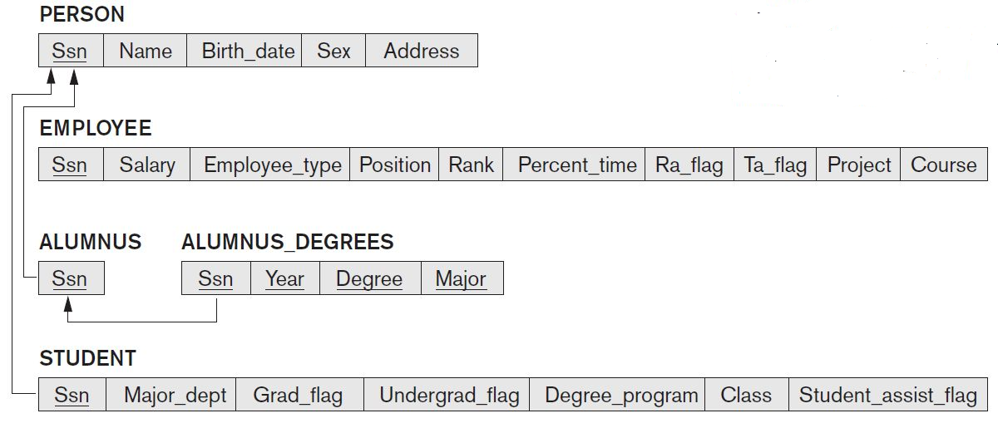

Slide 73
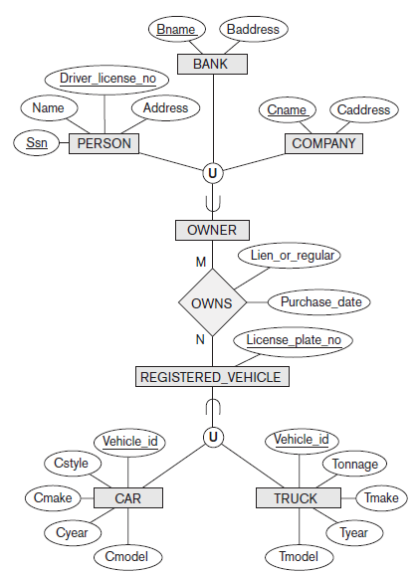

Slide 74
Mapping of Categories (Union Types)
add another step to the mapping procedure to handle categories
a category (or union type) is a subclass of the union of two or more superclasses that can have different keys because they can be of different entity types
an example is the OWNER category which is a subset of the union of three entity types PERSON, BANK, and COMPANY
the other category in that figure, REGISTERED_VEHICLE, has two superclasses that have the same key attribute

Slide 75
Step 9: Mapping of Union Types (Categories).
for mapping a category whose defining superclasses have different keys, it is customary to specify a new key attribute, called a surrogate key, when creating a relation to correspond to the union type
the keys of the defining classes are different, so we cannot use any one of them exclusively to identify all entities in the relation
in our example we create a relation OWNER to correspond to OWNER category and include any attributes of the category in this relation
the primary key of the OWNER relation is the surrogate key, which we called Owner_id

Slide 76
Step 9: Mapping of Union Types (Categories).
also, include the surrogate key attribute Owner_id as foreign key in each relation corresponding to a superclass of the category, to specify the correspondence in values between the surrogate key and the original key of each superclass
if a particular PERSON (or BANK or COMPANY) entity is not a member of OWNER, it would have a NULL value for its Owner_id attribute in its corresponding tuple in the PERSON (or BANK or COMPANY) relation, and it would not have a tuple in the OWNER relation
also recommended to add a type attribute to the OWNER relation to indicate the particular entity type to which each tuple belongs (PERSON or BANK or COMPANY)

Slide 77
Step 9: Mapping of Union Types (Categories).
for a category whose superclasses have the same key, such as VEHICLE, there is no need for a surrogate key
mapping of the REGISTERED_VEHICLE category, which illustrates this case, is also shown in next figure

Slide 78
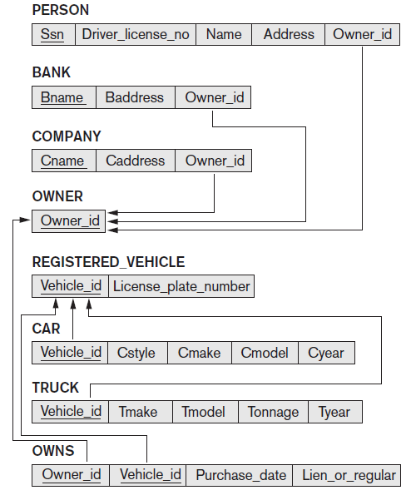

Slide 79
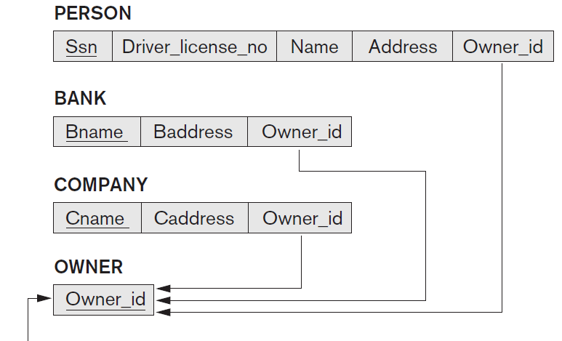

Slide 80
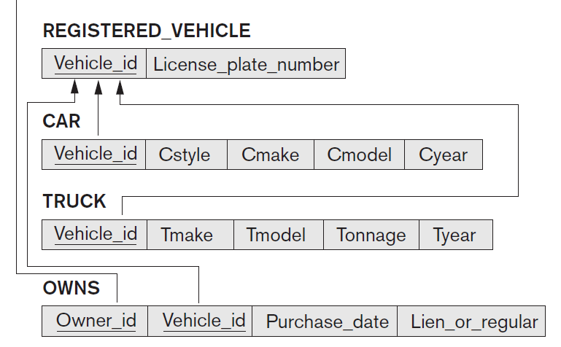

Slide 81
Andre Agassi Image Is Everything

Slide 82
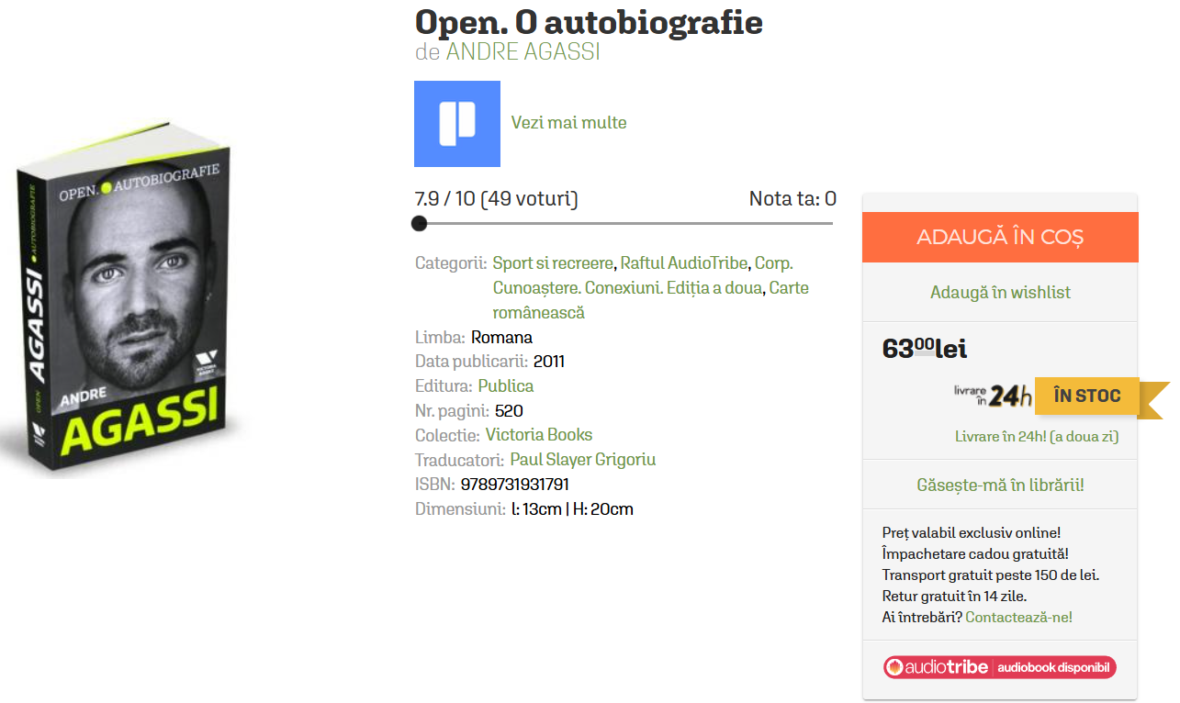
Open. O autobiografie - Andre Agassi
https://carturesti.ro/carte/open-o-autobiografie-55486?p=1&t=c_quick-search&s=agassi

Slide 83
Nike Men's New York Slam Crew | Tennis Warehouse Europe
https://www.tenniswarehouse-europe.com/Nike_Mens_New_York_Slam_Crew/descpageMANIKEA-NMUSLC-EN.html?color=CO&_gl=1*1kozfkj*_up*MQ..*_gs*MQ..&gclid=CjwKCAjw2vTFBhAuEiwAFaScwltgQ-3_bkmJIf478ZsZxLpngKUeXMCUz_J157cx_DXob6Uck9b1xhoCYWkQAvD_BwE

Slide 84


Slide 85
Product
Code
Name
Description
Price
Images
…
Publishing house, Authors, …
Brand, Collection, …

Slide 86
One product goes in the shopping cart
stock
share
One page on E-Commerce page
Many product goes in the shopping cart
different colors, size
stock
share
One page on E-Commerce page

